Slide 1
Chapter 18
Discriminant Analysis
SAS example

Slide 2
Discriminant Model
Our Example Model
Happy with standard of living = educ + marital status + spiritual person

Slide 3
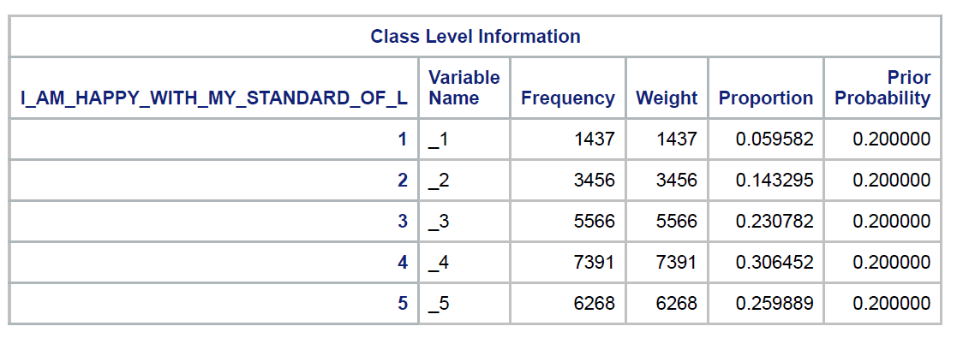
Discriminant Model
Our Dependent Variable

Slide 4
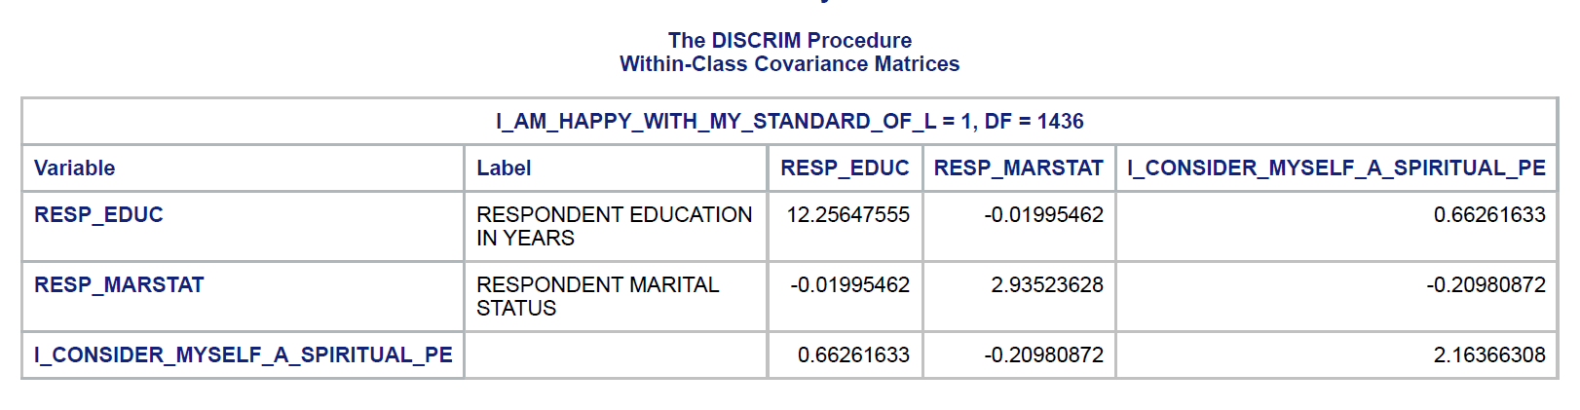
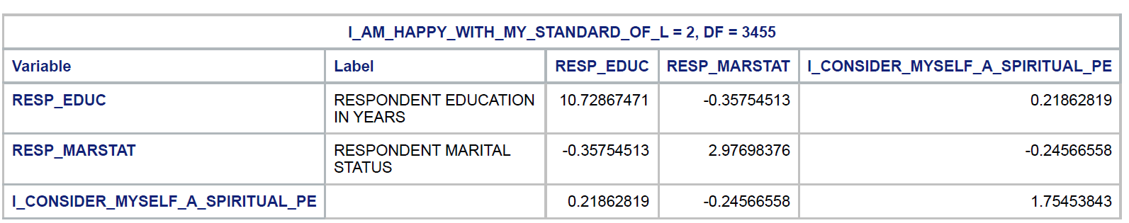
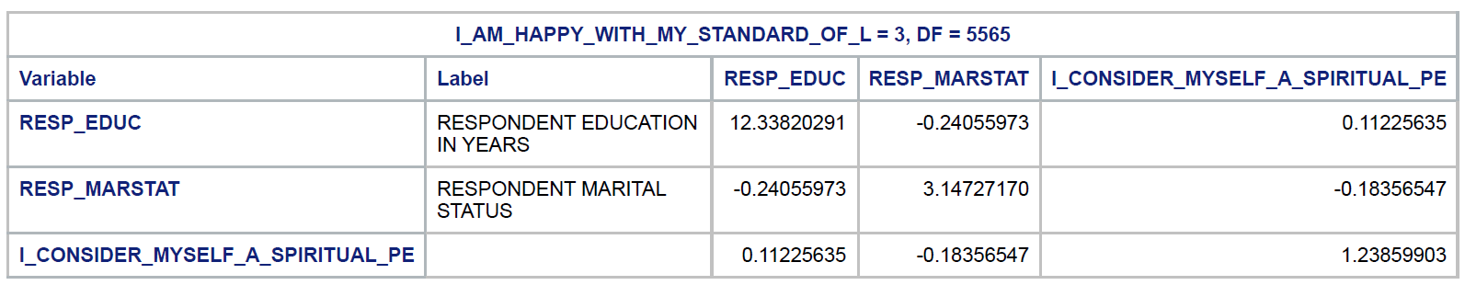
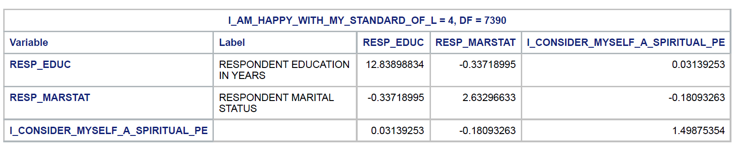
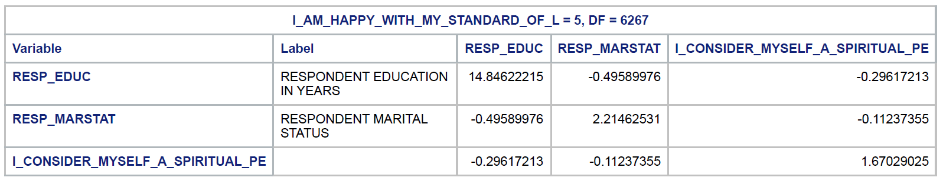
Discriminant Model
Our Separate Covariance Matrices

Slide 5
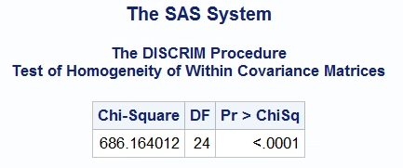
Discriminant Model
Can we pool the covariance matrices?
Nope – we have to consider them separate for each group

Slide 6
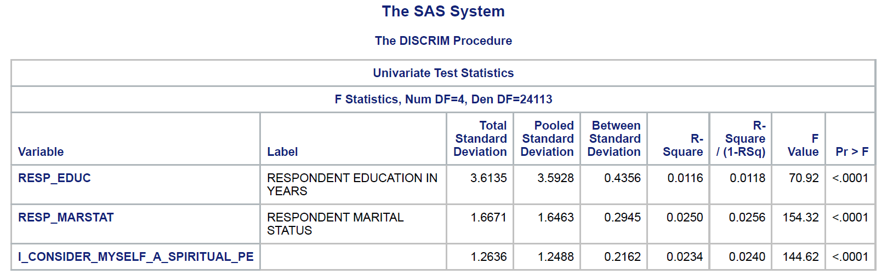
Comparison of DA to a set of univariate ANOVAs
Reporting multiple significance tests may lead to inflated risk of Type I error.

Slide 7
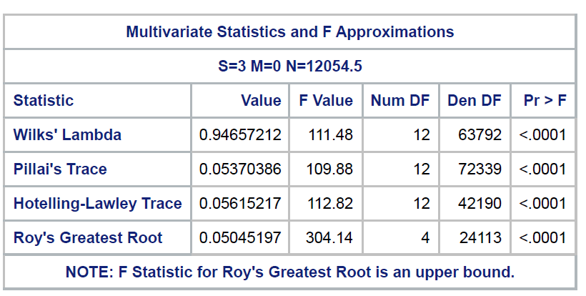
Discriminant Analysis Overall Test
We can see that taken together, the discriminant functions as a set are statistically significant

Slide 8
Discriminant Analysis Overall Test
We can see that taken together, the discriminant functions as a set are statistically significant

Slide 9
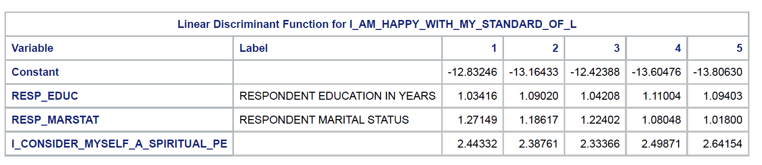
Discriminant Function Predictive Coefficients
We can see that taken together, the discriminant functions as a set are statistically significant

Slide 10
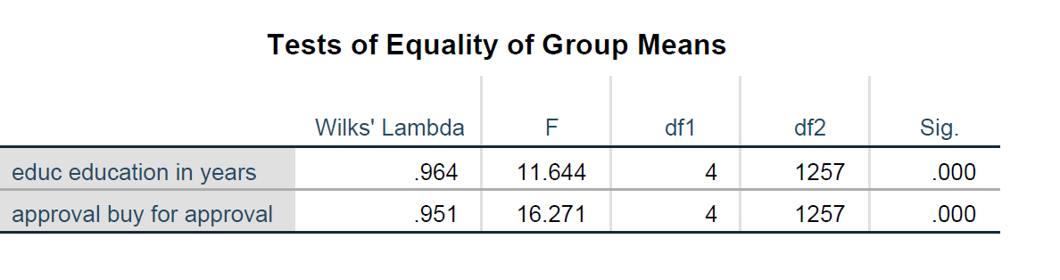
Comparison of DA to a set of univariate ANOVAs
Here are the univariate tests…

Slide 11
Comparison of DA to a set of univariate ANOVAs
3. DA may provide better statistical power for detection of group differences than a set of univariate ANOVAs (but not always).
4. Finally, when DA assesses between group differences in X scores, it statistically controls for correlations among the X variables (this is not taken into account in the univariate ANOVAs).

Slide 12
Research Questions in DA
For the entire set of all k groups, all p predictor variables, and all discriminant functions: does the DA predict group membership significantly?
The summary statistic that provides information this is Wilks’s Λ.
Statistical significance of Wilks’s Λ can be assessed by converting it to an (often approximate) F or χ².

Slide 13
Research questions in DA, continued:
2. How many of the discriminant functions obtained in the analysis provide useful information about differences among groups?
SPSS provides significance tests for sets of discriminant functions that can be used to decide how many discriminant functions provide useful information (“dimension reduction analysis”)
It may be possible, in some situations, to interpret discriminant functions as “dimensions” along which groups differ.

Slide 14
Example of Tests for Sets of Discriminant Functions
Set 1: D₁, D₂, D₃, D₄ p = .032
Set 2: D₂, D₃, D₄ p = .048
(all except first)
Set 3: D₃, D₄ p = .17
Set 4: D₄ p = .83
In this example, because set 4 and set 3 are not significant (α = .05), only the first two discriminant functions would be interpreted.

Slide 15
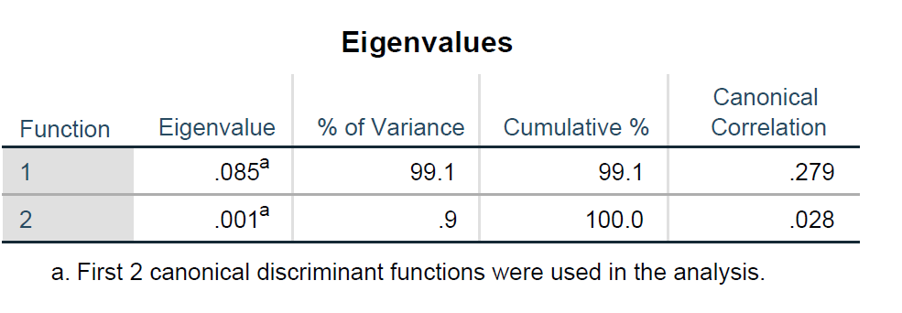
Loser rank order of function
Discriminant functions are “rank ordered” in terms of predictive strength; that is, D₁ is more highly predictive of group membership than D₂, D₂ more predictive than D₃, etc.
SPSS provides significance tests for the following sets of functions: so the model of function 1 and 2 will be used.

Slide 16

Note that to combine the SCPs across groups, we need to assume the corresponding population variance/covariance matrices (each denoted Σ) are equal:
This is analogous to the assumption of equal population variances H₀: σ²₁ = σ²₂ = … = σ²_{k} that should be met in one way ANOVA prior to computation of a pooled SS_{within} term.

Slide 17
Note that to combine the SCPs across groups, we need to assume the corresponding population variance/covariance matrices (each denoted Σ) are equal:

Slide 18
We are now able to set up a summary test statistic, Wilks Λ:
Λ = |SCP_{within}|/ |SCP_{total}|
Note that Λ differs from the summary F ratio statistic in one way ANOVA. F is obtained as MS_{between}/MS_{within}, thus, F is a ratio of explained to error variance, and a larger F indicates greater differences between groups.
By contrast, Λ is a ratio of error to total variance; and a larger value of Λ indicates smaller between group differences.

Slide 19
Two places where Λ appears in DA
SPSS DA reports Λ for the overall model (including all groups/ all variables/ all discriminant functions). This can be reported as an overall effect size.
SPSS DA also reports values of Λ for sets of discriminant functions, and these can be used to decide whether some discriminant functions do not contribute significantly to discrimination among groups and should not be interpreted.

Slide 20
Statistical Significance of Λ
Note that Λ is a multivariate test statistic that has three different df terms; these, in turn, are based on the values of k (number of groups), p (number of quantitative predictor variables) and N (total number of cases). For convenience, most programs convert Λ to an exact (or approximate) F or χ² statistic, and use critical values of F or χ² to test statistical significance.

Slide 21
DA Statistics Associated with Each Discriminant Function
For each discriminant function, an eigenvalue λ is reported.
= SS_{between}/SS_{within} for a one way ANOVA of scores on this discriminant function across groups.
Thus, the larger the value of λ, the greater the between groups differences in scores on the corresponding discriminant function

Slide 22
Test of entire model
D1 = d₁₁z₁ + d₁₂ z₂
D2 = d₂₁z₁ + d₂₂z₂

Slide 23
Coefficients for the standardized discriminant functions (applied to z scores on the Xs)
D1 = -.626 z₁ + .754 z₂
D2 = .781 z₁ + .659 z₂

Slide 24
Classification Table

Slide 25
Classification Table

Slide 26
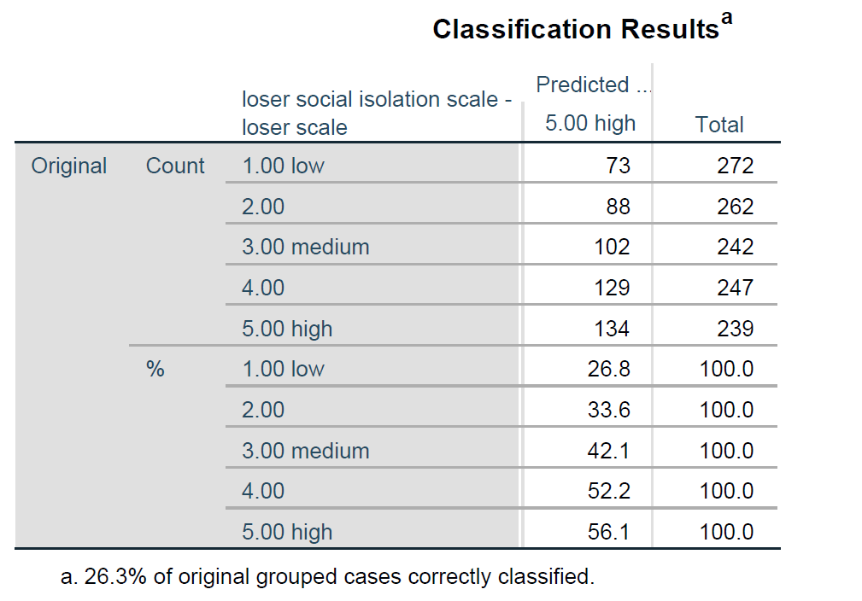
Classification Table

Slide 27
Classification Function Table

Slide 28
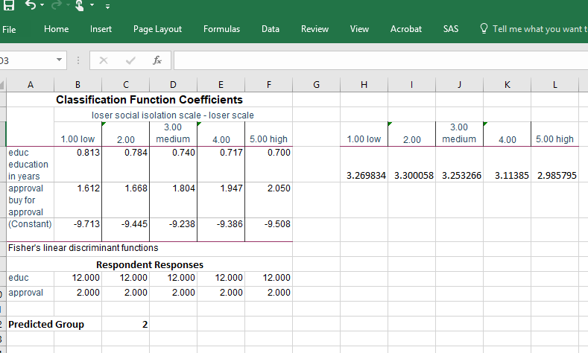
Predicted Group

